Slide 1
GROUP 7

Slide 2
INTRODUCTION
Mastermind is a classic code-breaking game in which a player attempts to guess a hidden sequence of symbols (colors or numbers). In computer science, the Mastermind problem is often used to demonstrate algorithm design, comparison strategies, and complexity analysis.
This mini project focuses on implementing two different algorithmic approaches to solve a simplified Mastermind problem and comparing their time and space complexities. Both approaches aim to determine the number of exact matches, where a guessed symbol matches the secret symbol in both value and position.

Slide 3
PROBLEM DESCRIPTION
Given:
A secret code represented as an integer array of length n
A guess code represented as another integer array of the same length n
Objective:
Count the number of positions where the secret code and guess code are exactly the same.
This project does not consider partial matches (correct symbol but wrong position); it focuses only on exact matches to simplify the complexity analysis.

Slide 4
Why Mastermind Is an AI Problem
Mastermind is a logic-based game that requires:
Reasoning under uncertainty
Decision-making based on partial information
Search within a large solution space
Optimization of future decisions
The goal of the AI agent is not only to find the correct code, but to do so using the minimum number of guesses.

Slide 5
Why Mastermind Is an AI Problem
Each possible secret code represents a state
For 4 positions and 6 colors:
    Total possible states = 6^4=1296
The AI starts with full uncertainty
Each feedback reduces the state space

Slide 6
AI Agent Model
AI Agent in Mastermind
Agent: The code-breaking algorithm
Environment: The Mastermind game
Percepts: Feedback from each guess
Actions: Selecting the next guess
The agent improves its performance based on previous feedback.

Slide 7
Constraint Satisfaction & Logical Reasoning
Each feedback introduces constraints:
Correct position constraint
Correct color but wrong position constraint
The AI eliminates all codes that violate these constraints.
This process is known as:
Constraint-based pruning

Slide 8
Search Space Reduction
After each guess:
Invalid solutions are removed
Remaining solutions form a reduced search space
This improves efficiency and accuracy in future guesses.
This is a form of:
Knowledge-based reasoning

Slide 9
Information Optimization
Every guess provides information
A good guess maximizes information gained
Poor guesses reduce little uncertainty
Algorithm 2 improves decision quality by:
Analyzing color frequencies
Choosing guesses that eliminate the most possibilities
This aligns with:
Information Gain Optimization

Slide 10
Recursive AI Reasoning
The AI follows a recursive reasoning cycle:
Make a guess
Receive feedback
Reduce the solution space
Call itself with updated knowledge
This continues until the correct code is found.

Slide 11
Comparing the Two AI Strategies
Strategy | AI Approach
Brute-force elimination | Basic logical pruning
Frequency-based method | Information optimization
Recursive reasoning | Decision refinement

Slide 12
Algorithm 1: Brute-Force
The first approach uses a simple brute-force strategy. The algorithm generates all possible code combinations and evaluates each guess sequentially. For every guess, it iterates through each position of the secret and guess arrays simultaneously and compares their values. If the values at the same index are equal, the count of exact matches is incremented. This process continues until all positions have been checked. This approach does not use any additional data structures, making it straightforward and memory-efficient.

Slide 13
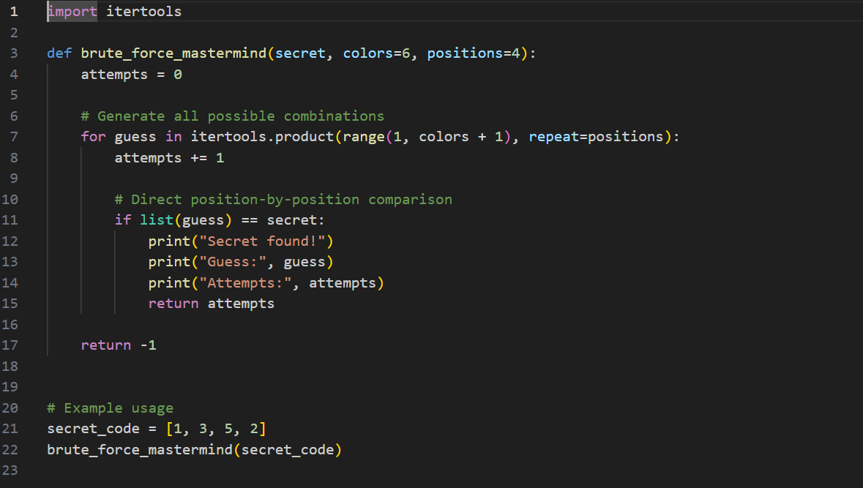
Implementation

Slide 14
COMPLEXITY ANALYSIS
Time Complexity
Time Complexity: O(C^P)
Explanation: The total number of possible combinations is determined by the number of colors raised to the power of the number of positions (e.g., 6^4 = 1,296). In the worst case, the algorithm must generate and check every single one of these combinations. This represents exponential growth, meaning even a small increase in positions (P) will drastically increase the time it takes to run.

Slide 15
COMPLEXITY ANALYSIS
Space Complexity
Space Complexity: O(P)
Explanation: The algorithim uses a generator (itertools.product), it only stores one guess in memory at a time. It does not need to save the entire list of thousands of combinations, keeping its memory footprint very low.

Slide 16
Algorithm 2: Frequency-Mastermind
The second approach introduces auxiliary frequency arrays to improve decision-making using additional memory. The algorithm generates possible guesses and evaluates them using both exact position comparison and frequency counts. Exact matches are counted immediately, while non-matching elements are tracked using frequency arrays. This additional information allows the algorithm to eliminate inconsistent guesses and reduce the search space. This approach reflects real-world Mastermind implementations where both exact and partial matches are required.

Slide 17
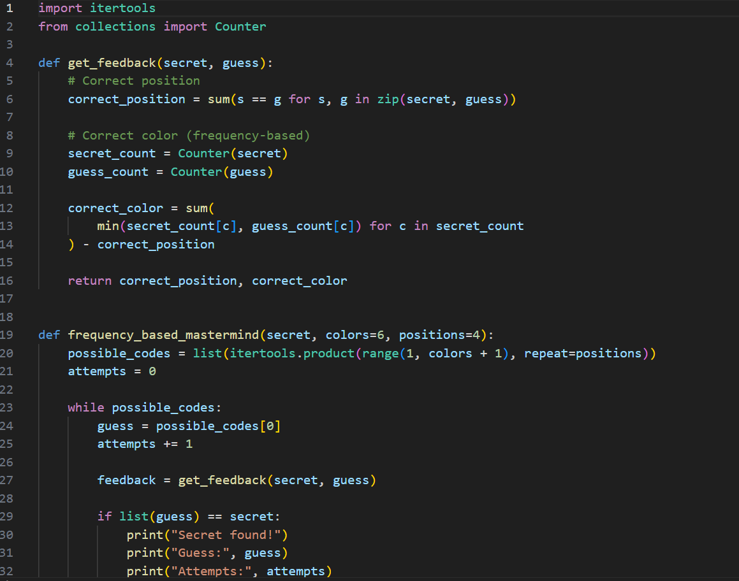
Implementation

Slide 18
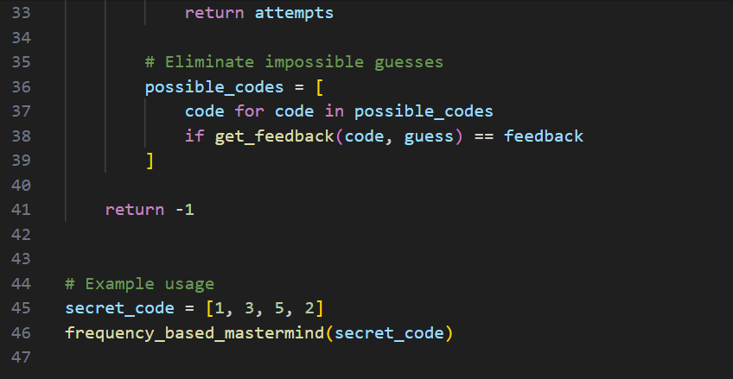

Slide 19
COMPLEXITY ANALYSIS
Time Complexity
Time Complexity: O(P + C)
Explanation: The algorithm performs a linear scan through the code positions (P) to tally the colors and then may iterate through the unique colors (C) to compare these tallies. It is much faster than brute force because it doesn't need to try every combination; it just looks at the data once.

Slide 20
COMPLEXITY ANALYSIS
Space Complexity
Space Complexity: O(C)
Explanation: This algorithm requires a "frequency table" (usually a dictionary or an array) to store the counts for each possible color. Therefore, the extra memory used is directly proportional to the number of available colors.

Slide 21
Recursive AI-Generated Solution
The Mastermind AI solves the puzzle using a recursive reasoning process. Each recursive call represents one guess made by the AI based on updated feedback.
At every step, the AI:
Makes a guess
Receives feedback
Eliminates impossible solutions
Recursively continues with reduced possibilities

Slide 22
Recursive Reasoning Flow
Start with all possible secret codes
AI selects a guess
Feedback is generated
Invalid codes are eliminated
The AI recursively repeats the process
Stop when the correct code is found
Base Case
When all positions are correctly matched

Slide 23
Recursive Pseudocode
function SolveMastermind(possibleCodes):
if solution found:
return
guess = SelectNextGuess(possibleCodes)
feedback = GetFeedback(guess)
reducedCodes = EliminateInvalidCodes(possibleCodes, guess, feedback)
SolveMastermind(reducedCodes)
This recursive structure models the AI’s decision-making process rather than a specific programming implementation.

Slide 24
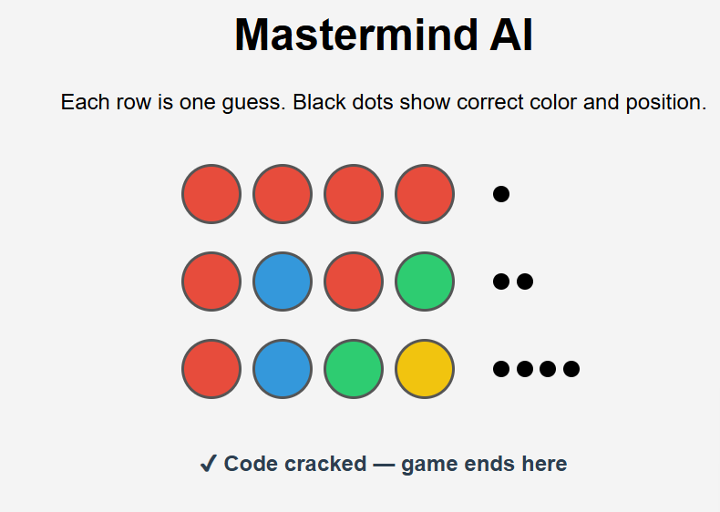
Graphical Animation of Recursive AI Solution
Screenshot from implemented HTML/JavaScript animation

Slide 25
Relationship to Our Two Algorithms
Algorithm 1 applies basic constraint elimination
Algorithm 2 applies optimized information-based elimination
The recursive structure represents the reasoning cycle common to both algorithms
Both algorithms differ in how the next guess is selected, but follow the same recursive decision process.

Slide 26
Why Recursion Is Used
Each guess depends on previous feedback
The problem naturally reduces in size
Recursion mirrors human logical reasoning
Enables clear step-by-step animation
Both algorithms differ in how the next guess is selected, but follow the same recursive decision process.

Slide 27
Feature | Algorithm 1 (Brute Force) | Algorithm 2 (Frequency-Based)
Time Complexity | O(C^P) | O(P + C)
Space Complexity | O(P) | O(C)
Extra Memory | No | Yes
Simplicity | Very simple | Moderate
Scalability | Low | High
Best Use | Small inputs | Extended Mastermind

Slide 28
CONCLUSION
In this project, we analyzed two distinct computational strategies to solve the Mastermind game. Our findings highlight the fundamental trade-off between algorithmic simplicity and computational performance
The Brute Force Approach: While highly intuitive and simple to implement, this method is constrained by its exponential time complexity (O(C^P)). As the number of colors or positions increases, the time required to find the secret code grows at an unmanageable rate. However, it remains the most memory-efficient option (O(P) space) as it processes only one combination at a time.
The Frequency-Based Approach: This method represents a significant optimization by utilizing a "count-and-compare" logic. By trading a small amount of memory to maintain a frequency table (O(C) space), we achieve linear time complexity (O(P + C)). This makes it the superior choice for high-performance applications where speed is a priority over minimal memory usage.

Slide 29
Final Verdict: For standard game sizes, Brute Force is a reliable and easy-to-code solution. However, for scaled environments or competitive AI, the Frequency-based algorithm is essential to ensure rapid response times and efficient processing.

